Slide 1
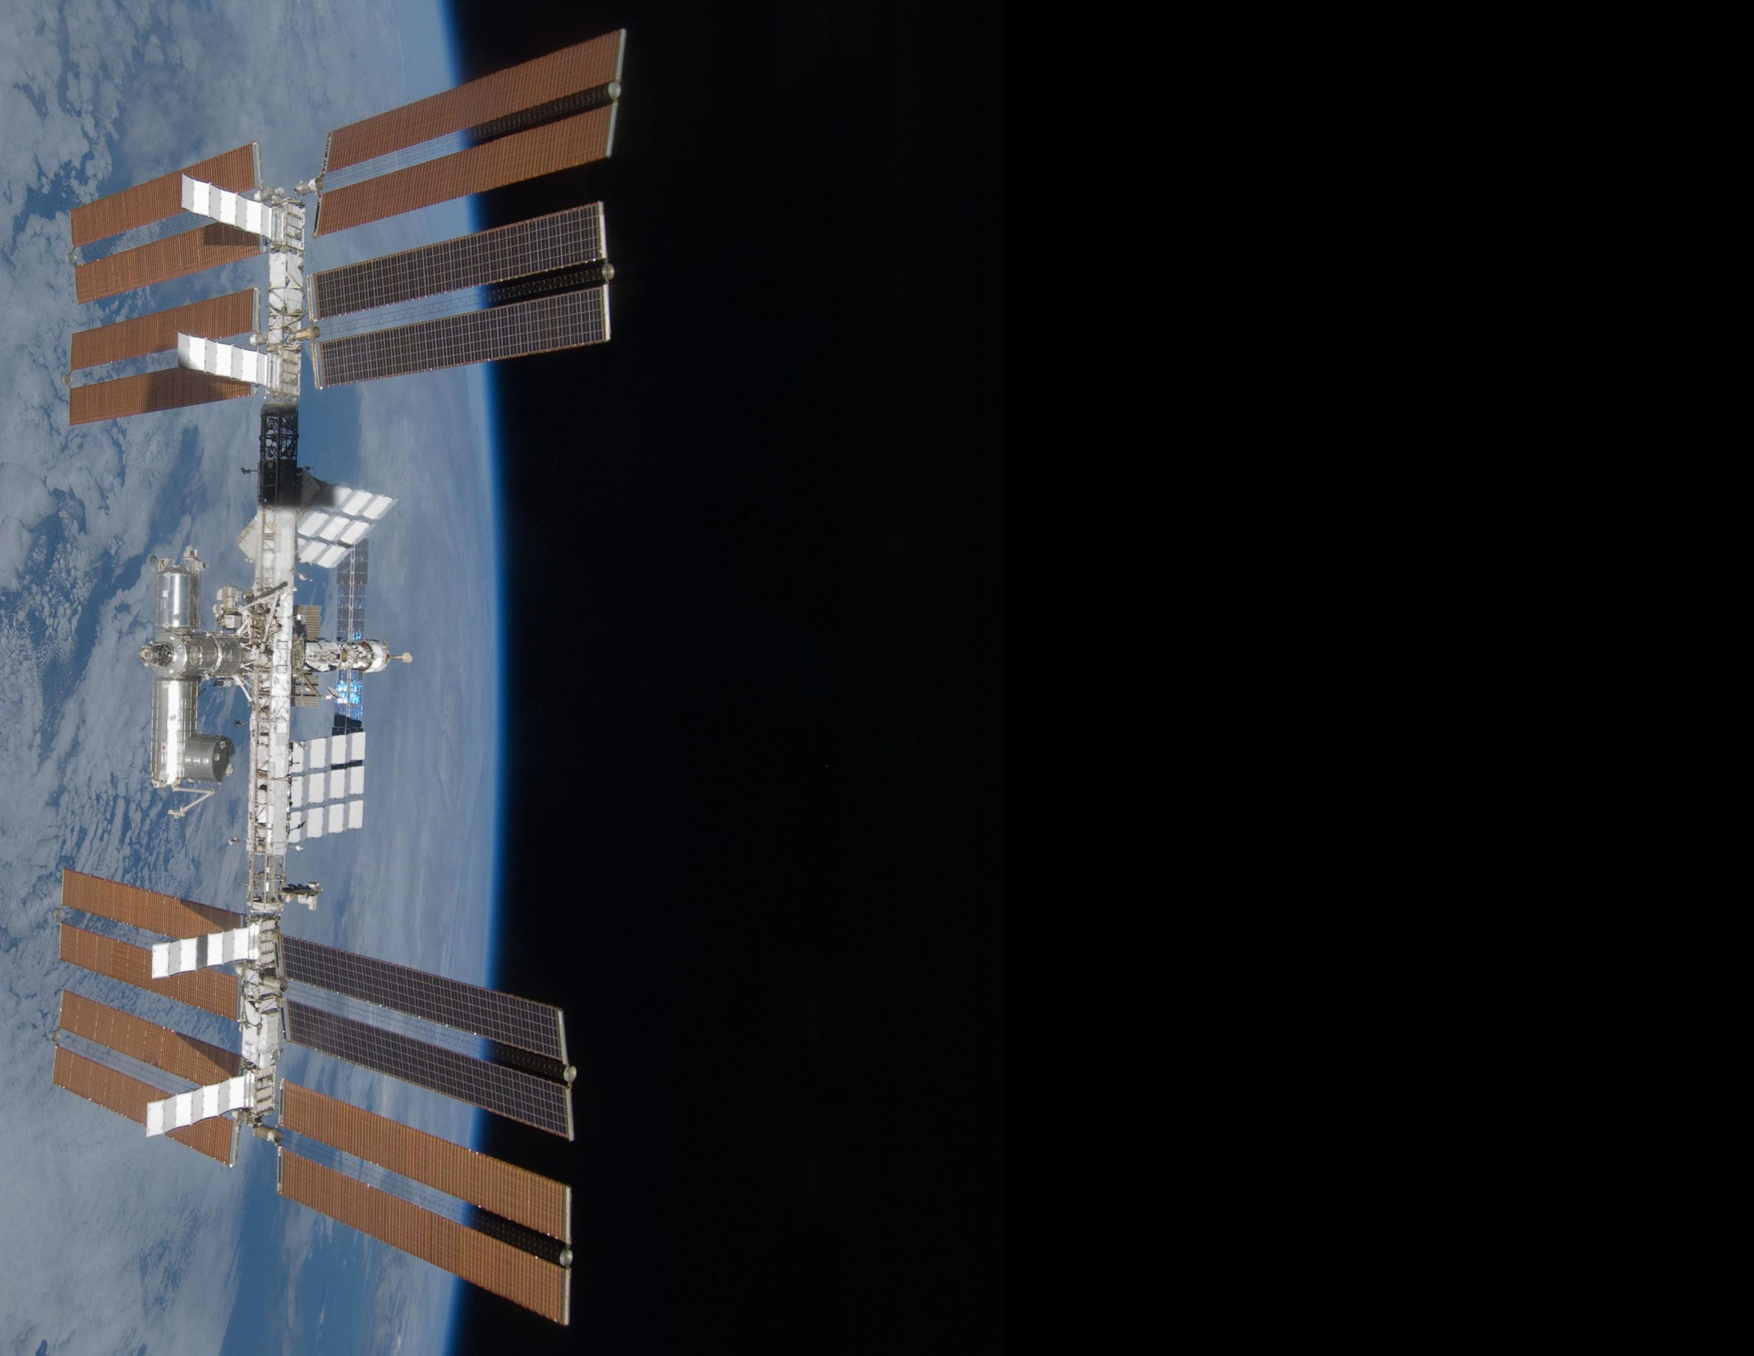

Near Real-Time State Models:
A foundational technology for space automation and robotics
AIAA Space Automation and Robotics Technical Committee Meeting
September 12, 2016
Presenter:
Gary Pearce Barnhard, President & CEO
Xtraordinary Innovative Space Partnerships, Inc.
(XISP-Inc)
gary.barnhard@xisp-inc.com
www.xisp-inc.com

Slide 2
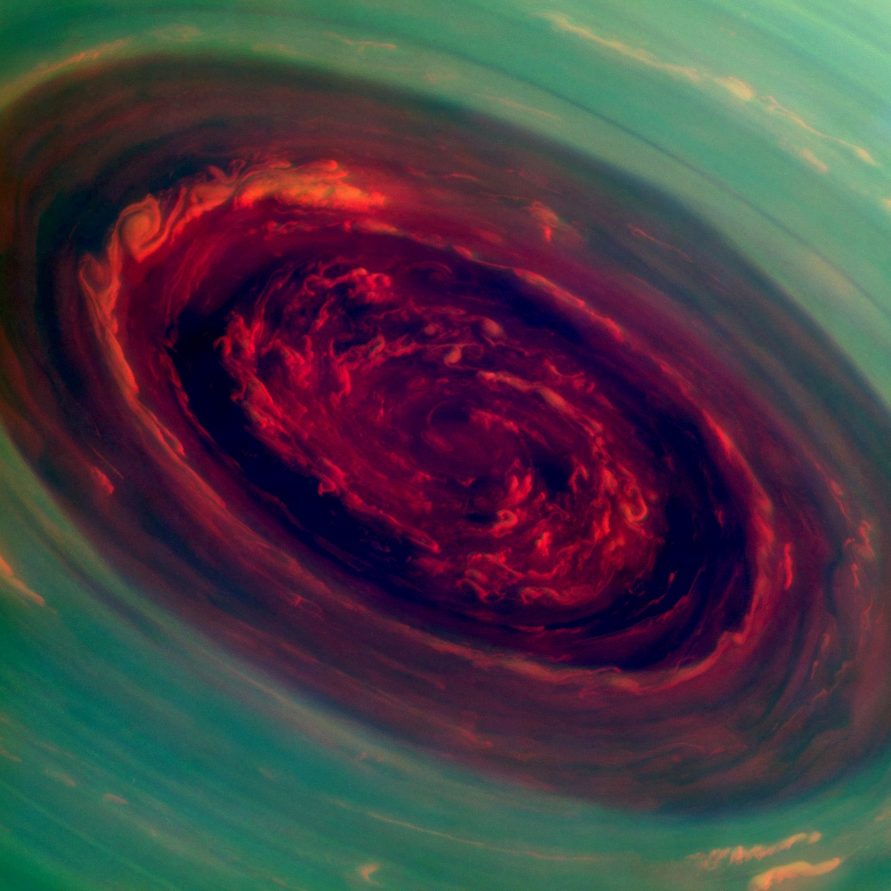
Outline
The Problem
DEXTRE is missing something
Making it real . . .
Building near realtime state models
Relationship with NASA
Relevance
XISP-Inc MOCA Supported Missions
Next Steps
Reality Check
Conclusion

Slide 3
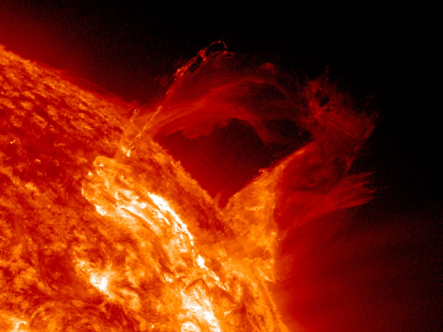
The Problem . . .
N-Dimensional interaction problems (i.e., an arbitrary number of objects interacting in an arbitrary number of ways) are a class of problems for which the generalized solution space is typically computationally intractable in any time frame.
Space automation and robotics present a subset of these problems that exacerbates the situation by requiring near real-time solutions in many instances.
              Reality is not a convenient problem or solution space . . .

Slide 4
EVA Robotics . . .

Slide 5
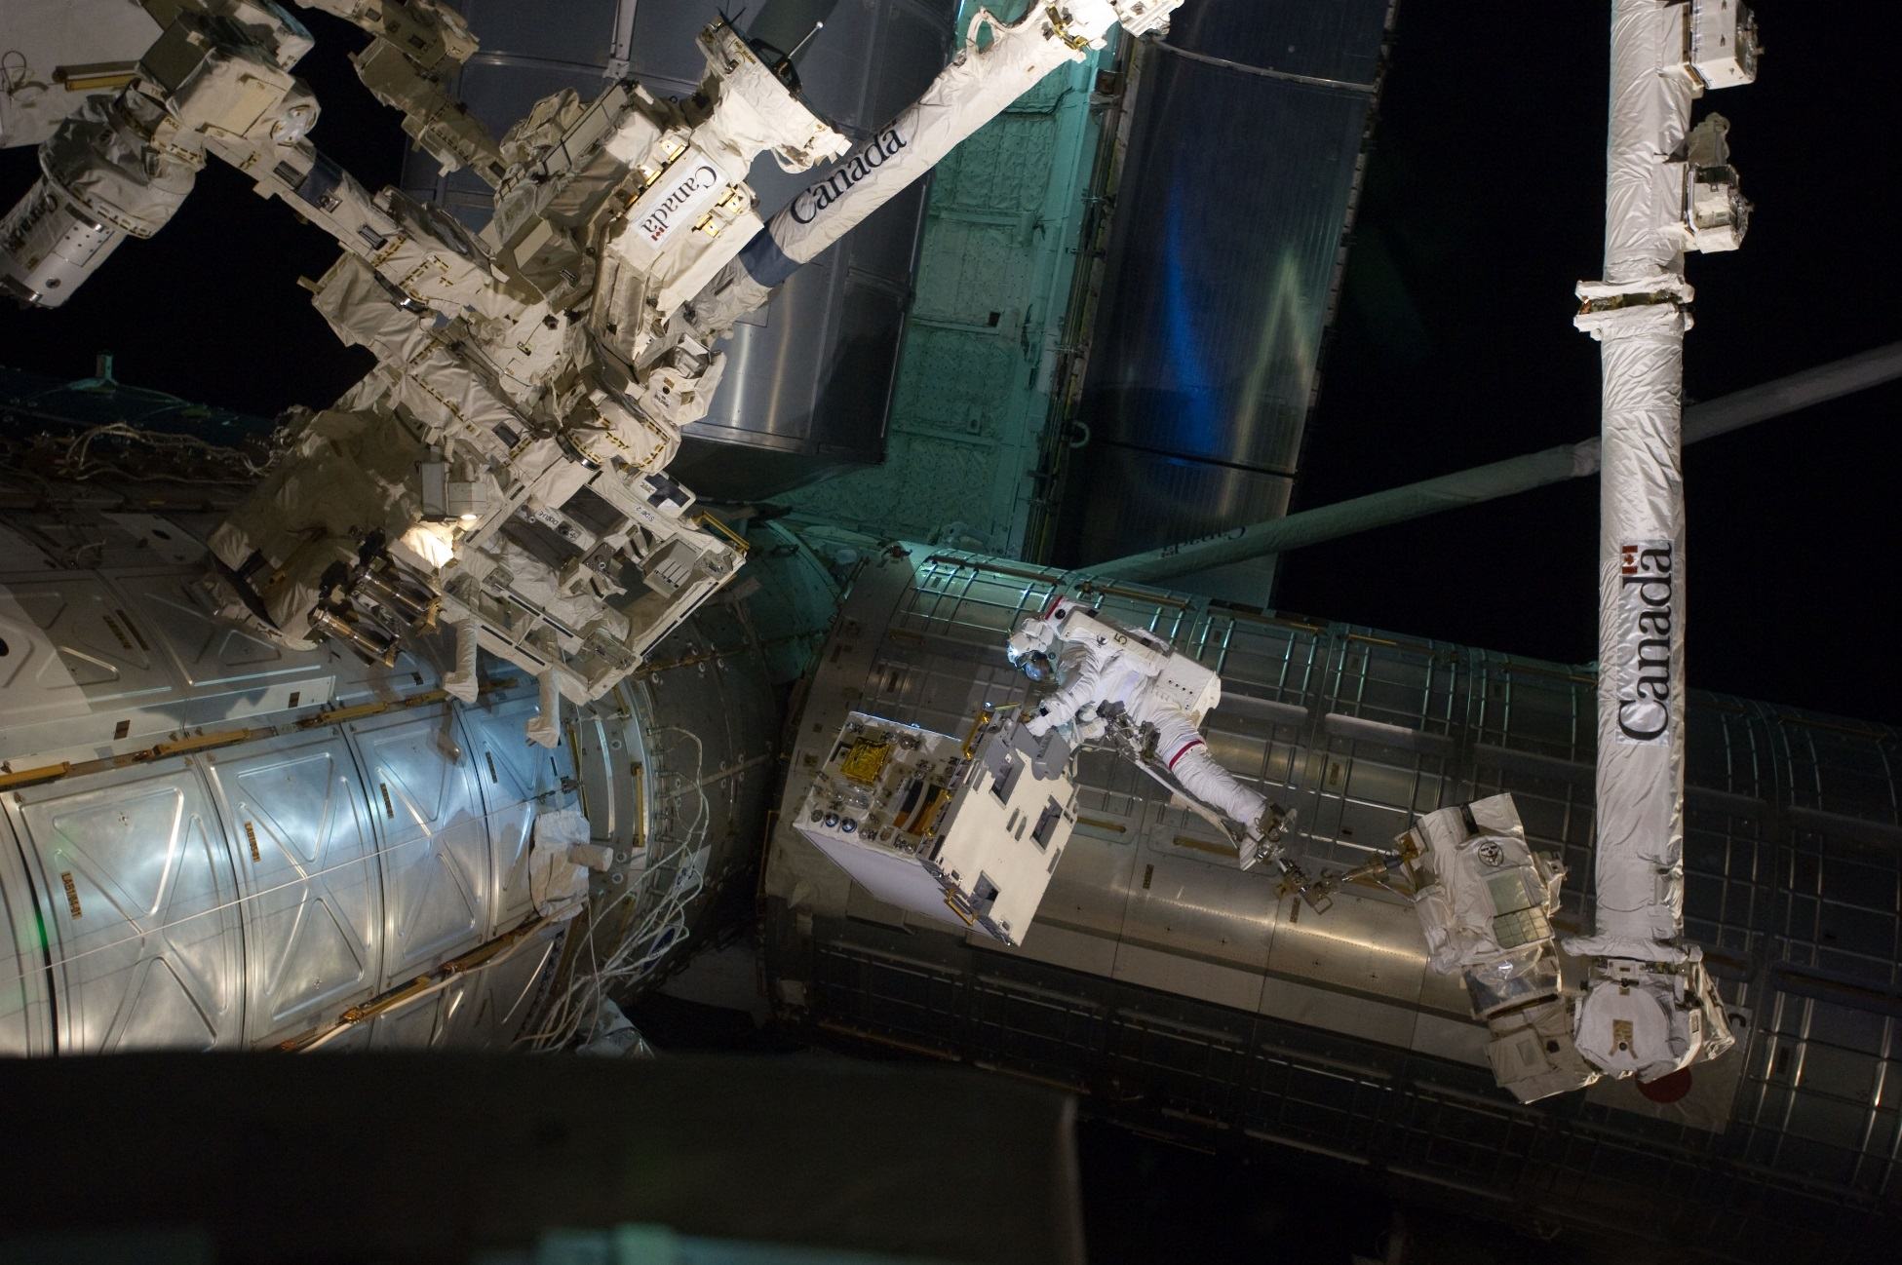
EVA Robotics & Crew . . .

Slide 6
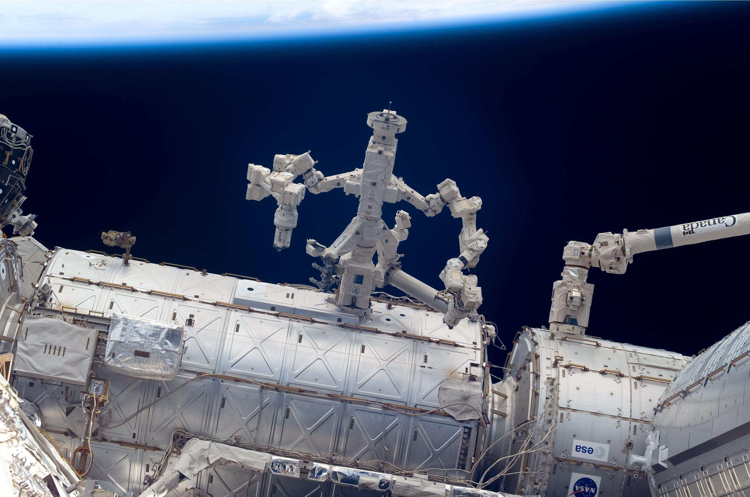
EVA Robotics . . .

Slide 7
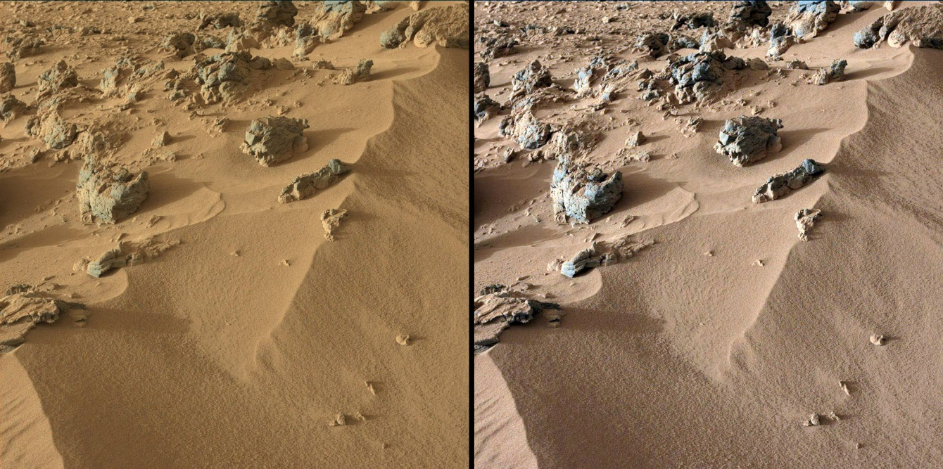
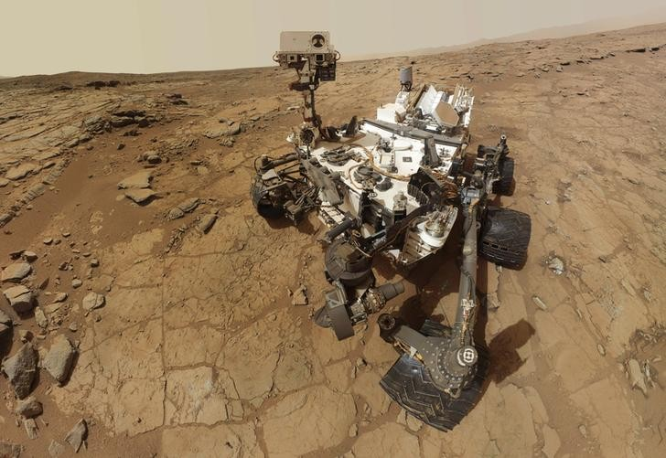
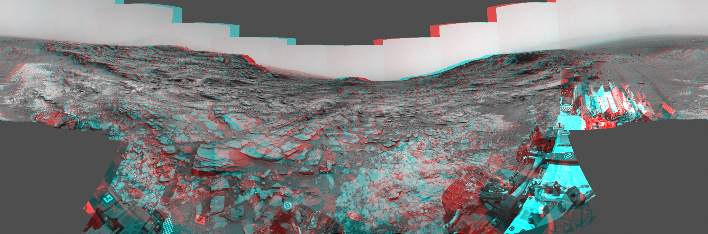
So you want to roam . . .

Slide 8
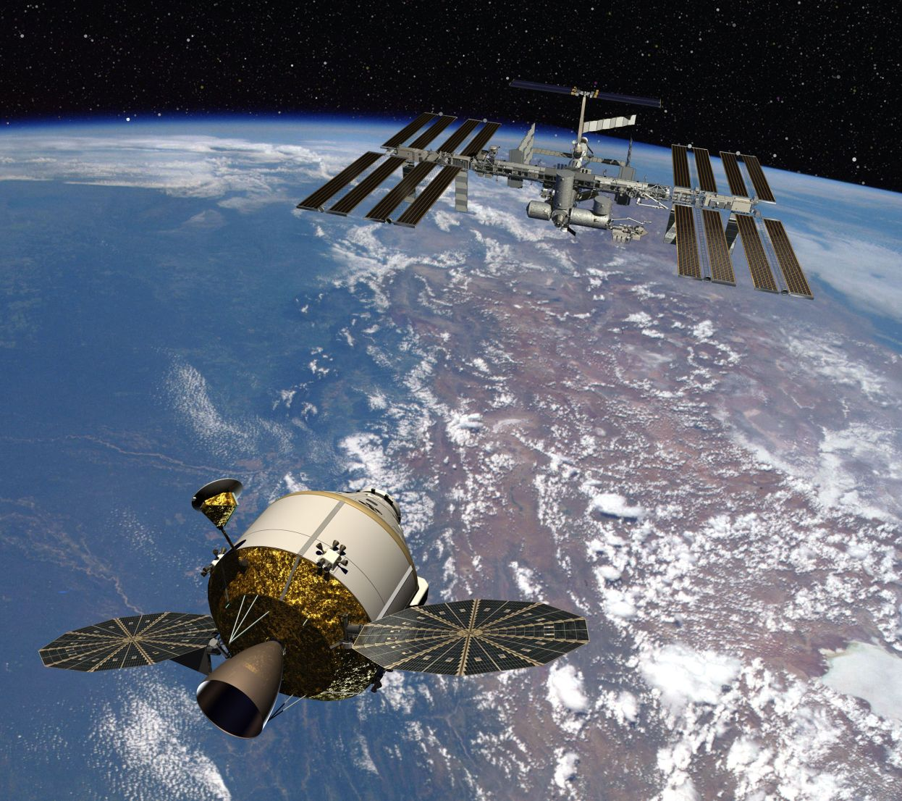
Going to Low Earth Orbit and Beyond . . .

Slide 9
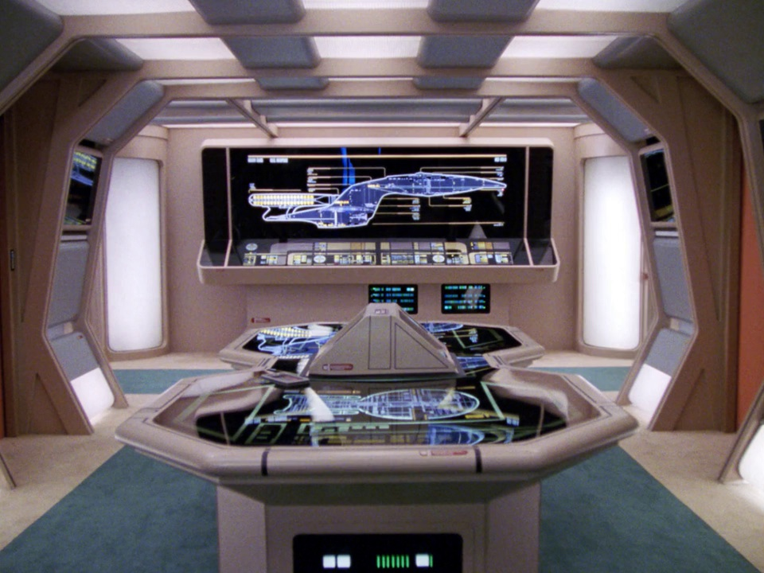
Perhaps even run a starship?

Slide 10
So let’s get real -- do you want to dance . . .

Slide 11
DEXTRE is missing something?
The Special Purpose Dexterous Manipulator (SPDM) aka DEXTRE was designed to have an Advanced Vision Unit (AVU)
The AVU was to provide a near realtime state model of the systems-of-systems that made up the SPDM – effectively an autonomic nervous system
In addition, it would have the ability to dynamically build up a world model of an assigned task area and it’s intersection with the environment
The combination of these two capabilities with the appropriate sensors/cameras/tags/targets/interfaces and the as-built documentation of the International Space Station was intended to support a mutable locus of control between full teleoperation and full autonomy
            The AVU was intended to allow the SPDM to effectively break dance with an EVA
            astronaut rather making paint drying seem like a spectator sport.

Slide 12
DEXTRE is missing something? - 2
Alas, it was estimated proximate to 1995 that implementing the AVU as intended would only take 25 times the anticipated available computational capacity of the International Space Station (ISS).
However, implementing the AVU using 2016 technology should and would be a much more straight forward proposition given . . .
  Multiple space qualified multi-core thermally managed processors
  Highly reliable registered Error Correcting Code (ECC) memory
  Solid state data storage systems
  Open source multi-threaded operating system amenable to near-realtime operations
  Multi-fault tolerant virtualizable functions and a generalized control architecture designed for failure tolerance
  Pervasively networked environment with access to as-built configuration data and relevant ISS operations and environmental data
            The same logic is applicable to any EVA/IVA robotics as well any advanced automated system

Slide 13
Making It Real . . .
The order of the problem to be solved must be reduced to something tractable
  Breakup problem space into many sub-problems suitable for parallel processing
  Focus on the sub-problems that matter
  Use boundary conditions, initial conditions, symmetry, known geometry, established datums, etc. to further reduce complexity
              The key is to propagate constraints as rapidly as possible

Slide 14
Making It Real . . .
A mutable locus of control is required between:
  Teleoperated and Autonomous Operations
  Ground and Inflight Operations
  Scheduled and Dynamic Operations
  Defined and Sensed Environments
  Referenced/Predicted/Sensed Geometry
  Toggled and Shared Control
              This necessitates near realtime state models of the involved systems and the environment

Slide 15
Making It Real . . .
N-Dimensional interaction problems do not have to be intractable.
With appropriate metadata, transforms can be applied.
  Data is a set of ordered symbols
  Data in context is information
  Information in perspective is knowledge
Problems of interest can be recast and structured as:
(Items(Attributes(Values))) -- LISP transform
They can then be modeled as a set of process flow problems.
Inference driven constraint propagation can then be applied to reduce the generalized solution space to a computationally tractable scale.
              The structure and ordering of knowledge makes a very real difference . . .

Slide 16
Building Near-Realtime State Models . . .
Systems-of-systems can be bounded as a finite set of state transitions
Systems can be modeled as a set of flows across defined interfaces
A taxonomy of flows can be defined as either energy, mass, or information and then further subdivided into individual types
Each type of flow can be defined by a specific set of qualitative and quantitative attributes, independent of the source and terminus
              Each set of characterized flows can be associated with corresponding states and allowable transitions.

Slide 17
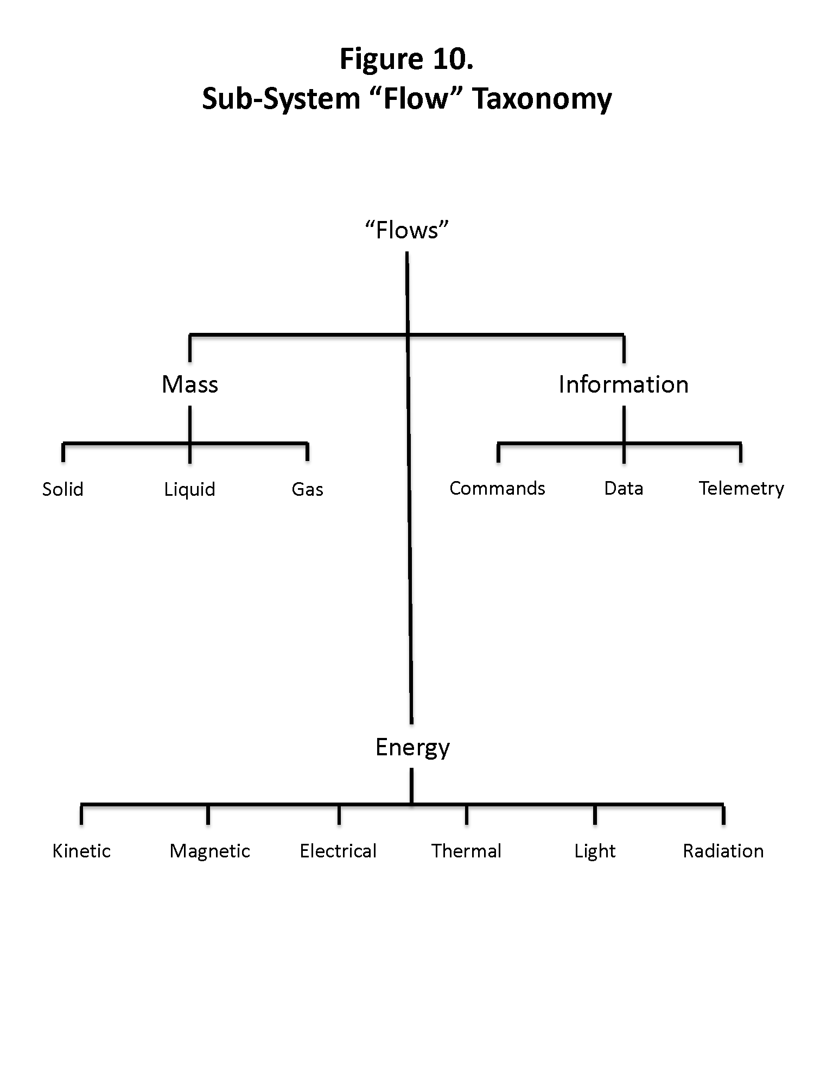
Relevance to NASA & Others - 2

Slide 18
Relationship with NASA
The NASA ARC Mission Control Technologies (MCT) Open MCT Web is the web based modular programming environment that is being enhanced by XISP-Inc to incorporate near realtime state model extensions.
This work is germane to the NASA ARC / XISP-Inc Space Act Agreement on Management Operations Control Applications (MOCA) and an overarching Space Act Umbrella Agreement under negotiation between NASA Headquarters and XISP-Inc.

Slide 19
Relevance
This body of work is an opportunity to craft viable technology demonstrations that will establish the basis for a confluence of interest between real mission users and the technology development effort.
This can lead to a range of technology development missions on ISS and subsequent flight opportunities that can make efficient and effective use of near realtime state models and the enhanced Open MCT Web Software suite

Slide 20
XISP-Inc MOCA Supported Missions
Team Alpha CubeSat (ACS) NASA Cube Quest Challenge
  Operations of 6U Cubesat
Space-to-Space Power Beaming (SSPB)
  Effective use of radiant energy beam components
Interoperable Network Communications Architecture (INCA)
  Testing DTN with real world requirements
  Pervasively networked DTN gateway
Advanced Vision and Task Area Recognition (AVaTAR)
  Support mutable locus of control between teleoperation and autonomy on a shared control basis

Slide 21
MOCA Mission Initial Objectives
Defining and prototyping parametric state models for integrated end-to-end mission operations control applications.
Implementing the parametric state models for technology development and demonstration mission prototypes, test and flight articles.
This effort includes the incremental, iterative, and recursive development of near real-time state models of all the supported mission components operating within the MCT framework/environment

Slide 22
MOCA Initial Products for Supported Missions*
Development of a paper model and individual element protocode;
Development of functioning individual element models and an end-to-end model protocode;
Optimization of individual element models and a functioning end-to-end model;
Testing of the optimized end-to-end model and individual element models in mixed modes (protoflight hardware and software with simulation as needed).
            * MOCA progress for each supported mission is being driven by the status and schedule of each mission and the availability of resources.

Slide 23
MOCA Extended Activities
MOCA extended activities will focus on actual on-orbit demonstrations and testing the efficacy of the near realtime parametric state models developed for the supported missions.
Follow-on activities will focus on assessing, reviewing, and establishing the efficacy of applying the near real-time parametric state modelling tools to other current and future technology development missions.

Slide 29

Next Steps
MOCA is now a commercial mission that will be worked with NASA through a combination of established and proposed Space Act Agreements.
MOCA is intended to be a foundation for moving forward with the AVaTAR mission
Additional partners/participants are being sought in the commercial, academic, non-profit, and government sectors.
Use of ISS helps ensure that this is an international cooperative/collaborative research effort.

Slide 30
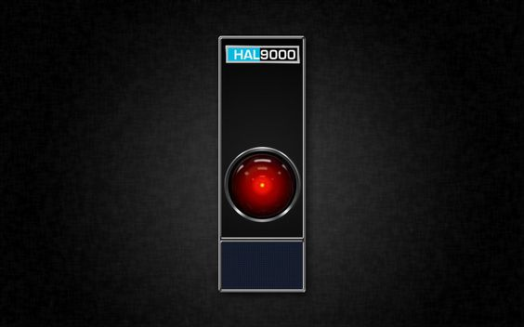
Reality Check
Reducing the number of perceived “impossible things that have to be accepted before breakfast”* is a way of incrementally disabusing people of unfounded notions.
Doing something real with the technology that is of demonstrable value can help to establish the confluence of interests necessary to mature the technology for more advanced applications.
* Allusion to “Alice in Wonderland” by Lewis Carroll. "Alice laughed: "There's no use trying," she said; "one can't believe impossible things."
"I daresay you haven't had much practice," said the Queen. "When I was younger, I always did it for half an hour a day. Why, sometimes I've believed as many as six impossible things before breakfast."

Slide 31
Conclusion
An incremental investment in the development of near realtime state modelling capabilities that meet real mission requirements can serve as a foundational technology for evolving space automation and robotics capabilities.
This work can deliver:
    Reduced cost, schedule & technical risk
        Mission enhancing technology
      ➔Mission enabling technology

